Slide 1

EMPLOYEE MANAGEMENT SYSTEM

Slide 2
ABOUT US
Name : Ashwitha Rasala
Background: B.Tech in Computer Science and Engineering.
Why Data Science: To transform data into actionable insights and solve real-world business problems using SQL, Python, and analytics.
GitHub: https://github.com/RasalaAshwitha
Name : G.Sanjana Priya
Background: B.Tech in Electronics and Communication Engineering.
Why Data Science: I want to learn data science because turn raw data into actionable insights that create business value.
GitHub: https://github.com/sanjanapriya21
Name : K. Swetha
Background: B.Tech in Computer Science and Engineering .
Why Data Science: To solve real-world business problems using data, analytics, and technology.
GitHub:https://github.com/kalakotiSwetha

Slide 3
AGENDA
Introduction
Objective of the Project
ER Diagram
Key analysis questions
Conclusion
Experience/Challenges working

Slide 4
INTRODUCTION
An Employee Management System is a relational database designed to manage employee information digitally.
Instead of maintaining employee records manually, the system stores all organizational data in a centralized SQL database.
The database manages:
Entity | Information Stored
👨 Employee | Employee ID, Name, Gender, Contact
🏢 Department | Department Name
💼 Job | Job Role, Salary Range
💰 Salary | Salary Amount, Bonus
🎓 Qualification | Employee Education
📝 Leaves | Leave Details
💵 Payroll | Salary Payment Details

Slide 5
OBJECTIVE OF THE PROJECT
Analyse employee data using SQL to generate meaningful HR and business insights.
Manage employee, department, salary, payroll, qualification, and leave records through a centralized database.
Ensure data integrity and minimize redundancy using database normalization, Primary Keys, and Foreign Keys.
Support HR decision-making by answering real-world business queries and generating accurate SQL reports.

Slide 6
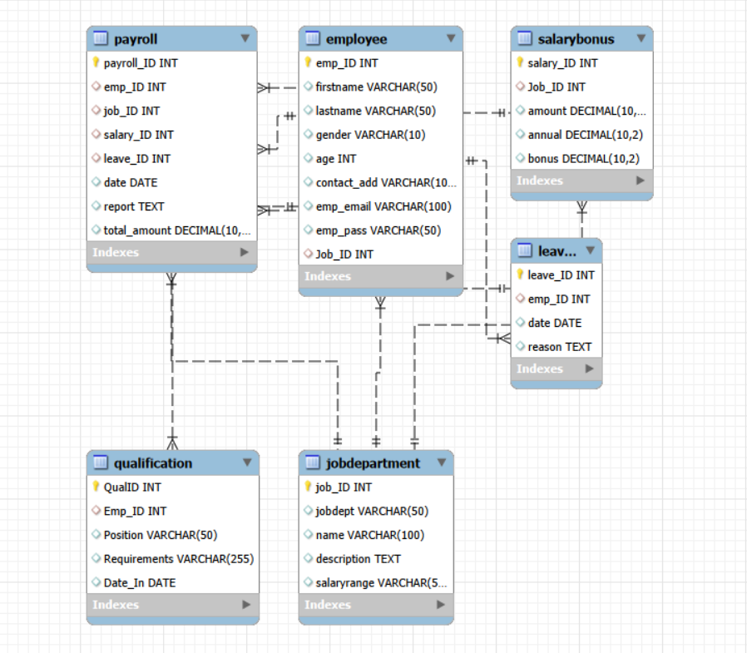
ER DIAGRAM

Slide 7
KEY ANALYSIS QUESTIONS
How many employees are working in the organization?
Which department has the highest number of employees?
Which department has the highest total monthly salary allocation?
Who are the Top 3 employees receiving the highest total compensation (Salary + Bonus)?
Which qualification is most common among employees?
What are the most common reasons employees take leave?
Which department has the highest average payroll amount?

Slide 8

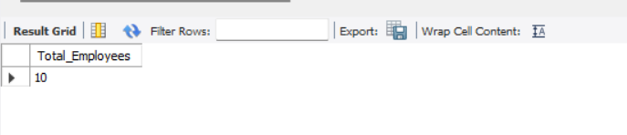
How many employees are working in the organization?
QUERY

Slide 9
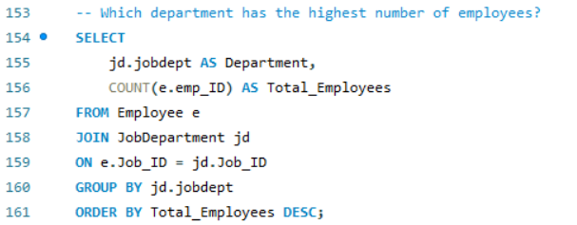
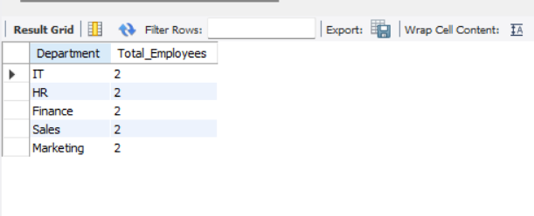
Which department has the highest number of employees?
QUERY

Slide 10
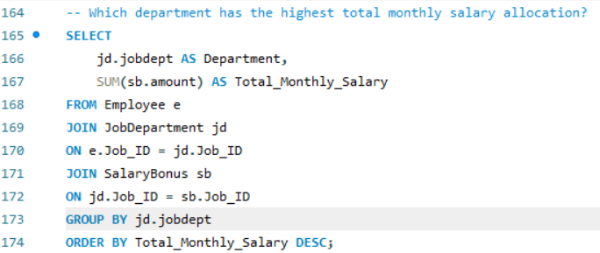
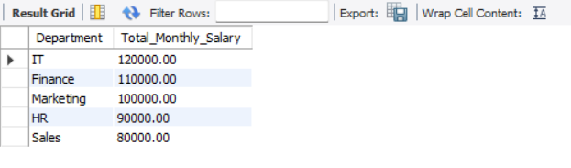
Which department has the highest total monthly salary allocation?
QUERY

Slide 11
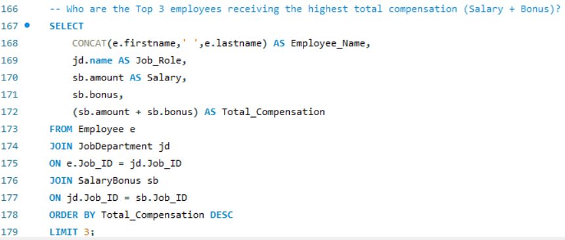
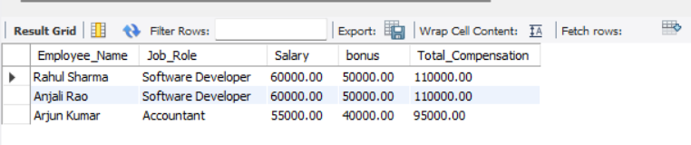
Who are the Top 3 employees receiving the highest total compensation (Salary + Bonus)?
QUERY

Slide 12
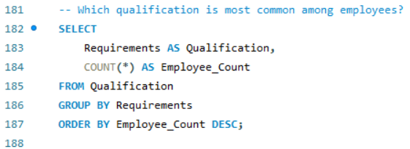
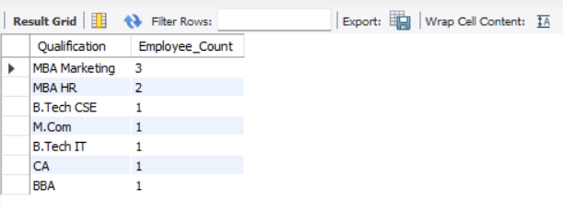
Which qualification is most common among employees?
QUERY

Slide 13
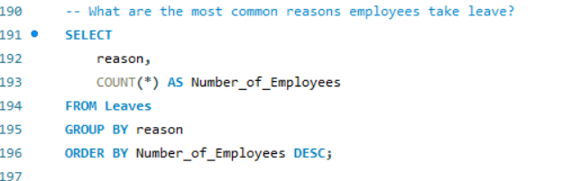
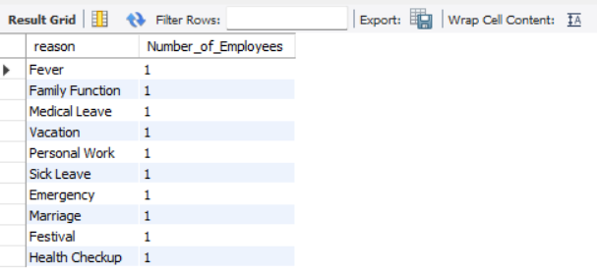
What are the most common reasons employees take leave?
QUERY

Slide 14
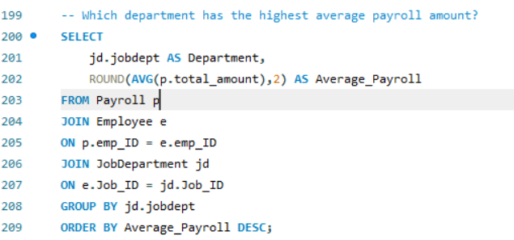
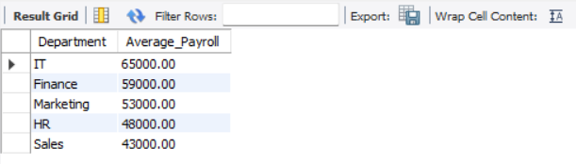
Which department has the highest average payroll amount?
QUERY

Slide 15
CONCLUSION
Developed an Employee Management System using SQL.
Managed employee, department, salary, qualification, leave, and payroll data.
Used SQL queries to generate useful business reports.
Learned database design, table relationships, JOINs, GROUP BY, and aggregate functions.
Improved problem-solving and business analysis skills.
Understood how SQL helps organizations make better HR and business decisions.

Slide 16
EXPERIENCE/CHALLENGES WORKING
Gained hands-on experience in designing a relational database and writing SQL queries for business analysis.
Improved SQL skills by working with JOINs, GROUP BY, aggregate functions, and table relationships.
Faced challenges in designing relationships between multiple tables and ensuring data integrity using Primary and Foreign Keys.
Enhanced problem-solving skills by converting business requirements into meaningful SQL queries and reports.

Slide 17

THANK YOU

